Slide 1
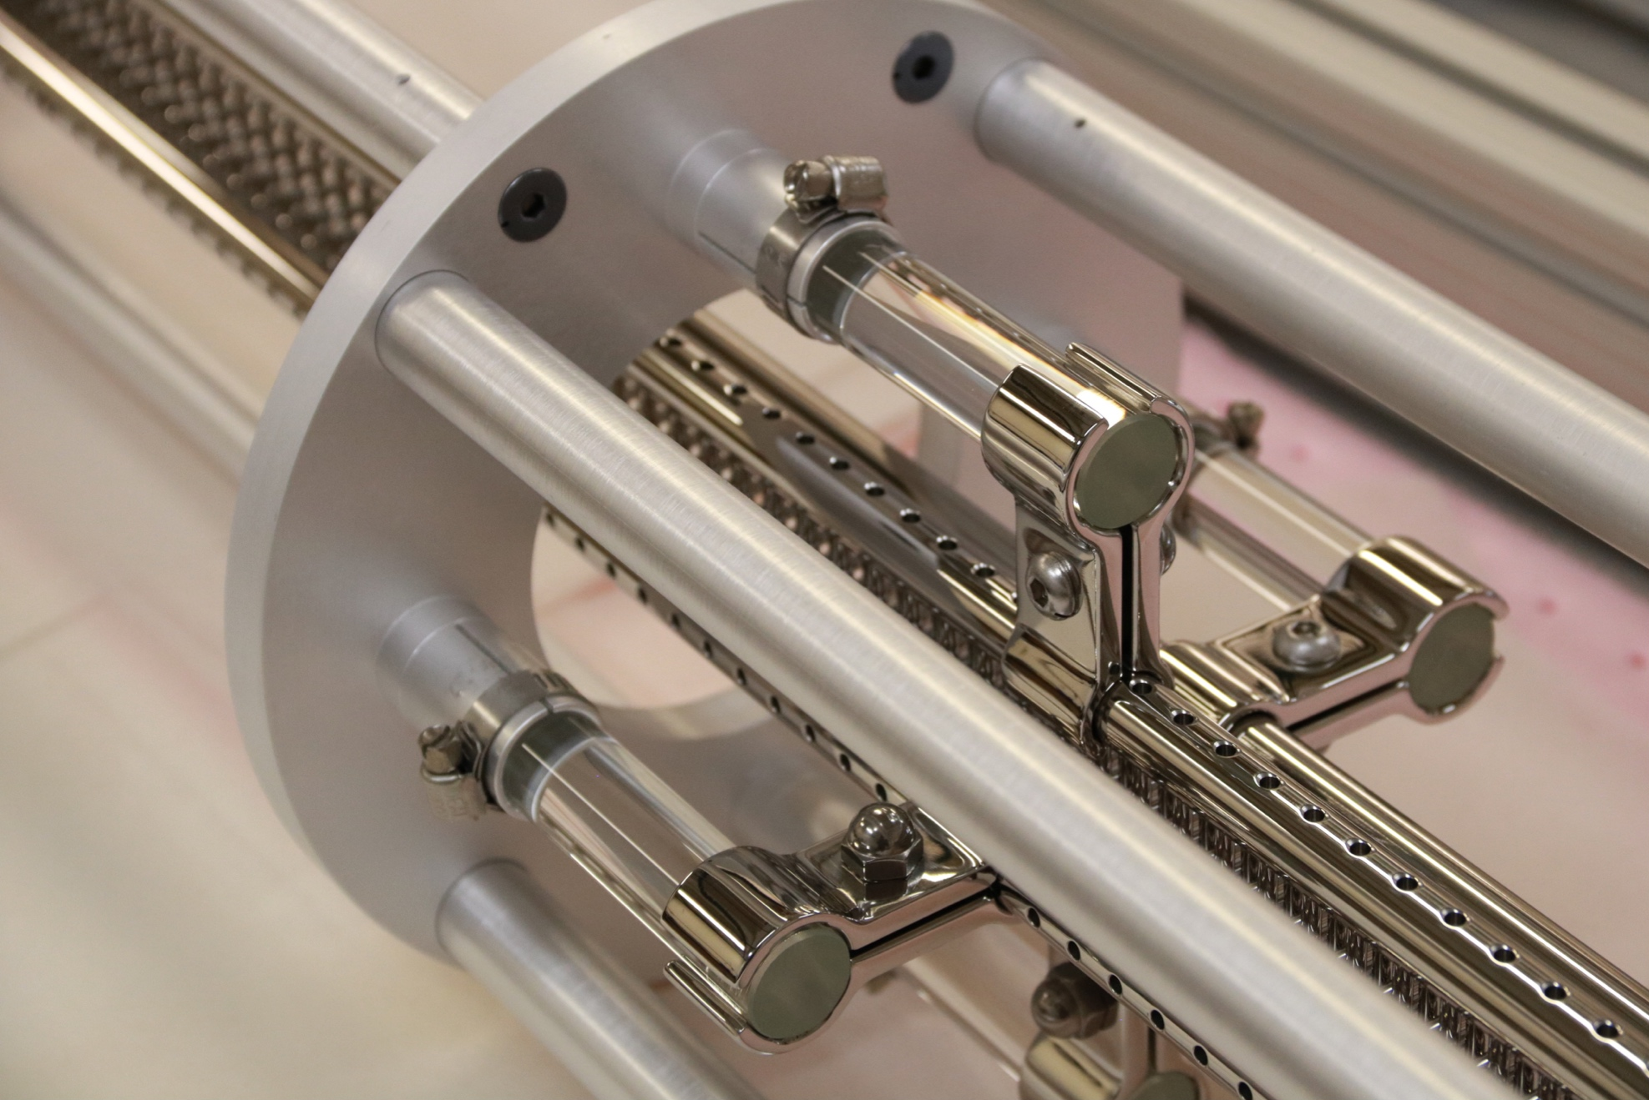
Pushing the Limits for Directly Cooled Molecules
David Reens
6/17/19
Jun Ye Group
Notes:
Hello Everyone, pleasure to be here, thanks John and Jeremy for inviting me,
Abstract:
A longstanding goal of the AMO physics community is to extend the successes and capabilities of the field to new molecular species. Incredible progress has been made in recent years by applying laser cooling techniques to suitable molecules and by associating ultracold atoms to form molecules. Nonetheless, with respect to the full diversity of molecular systems of interest, such highly specific schemes only scratch the surface. I report on exciting developments in the direct cooling and trapping of hydroxyl radicals, performed in a manner applicable to a broad class of candidate species. Despite significant setbacks, an improvement by nearly two orders of magnitude in the available molecule density is obtained.

Slide 2
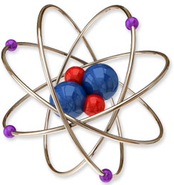
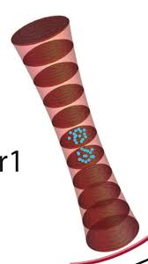
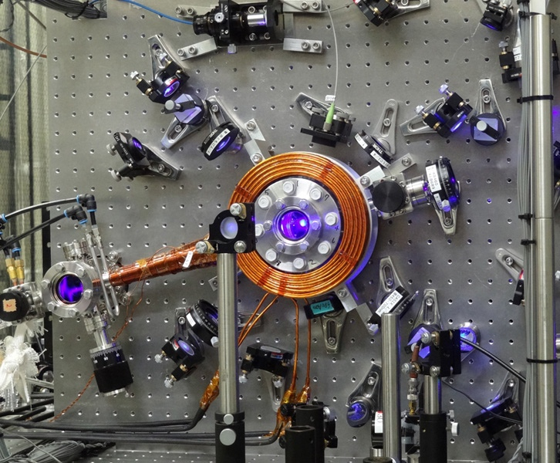
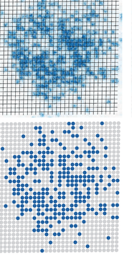
Motivation: Atomic, Molecular, & Optical Physics
AMO Physics: Repeatability, Precision.
Indistinguishability
Symmetry, enabling optical
pumping, cooling.

Slide 3
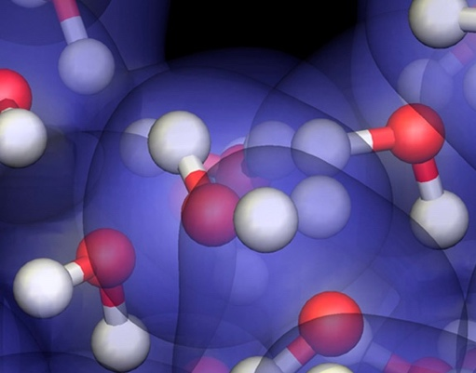
Motivation: Atomic, Molecular, & Optical Physics
AMO Physics: Repeatability, Precision.
Indistinguishability
Symmetry, enabling optical
AMO Physics: Trade low Entropy for…
Long Range Interactions
New Quantum Phases
Decoupled Transitions
Relevance to Chemistry,
pumping, cooling.
Astrophysics, Biology.
Image credit: Paul Kent, National Center For Computational Sciences, Ornl/Jorge Sofo, Penn State University/Science Photo Library

Slide 4
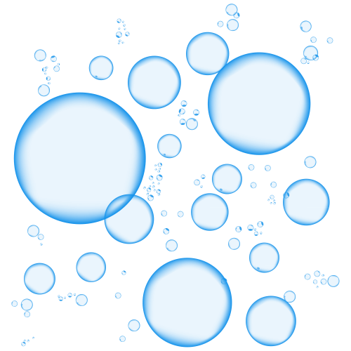
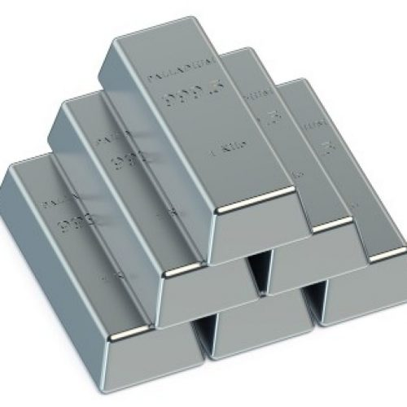
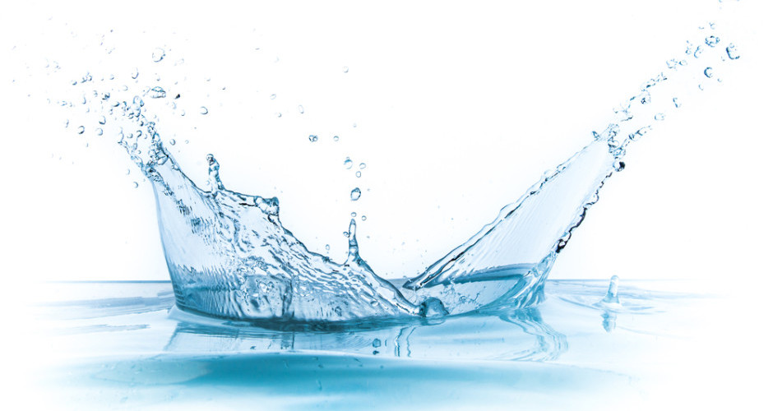
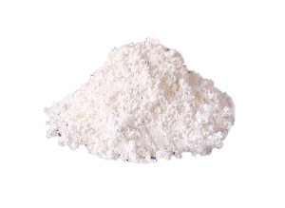
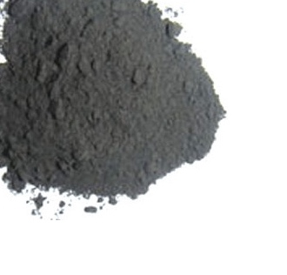
Backstory
Why atoms or molecules?
John Dalton, 1808, integer combinations:
Tin Oxide:
100 gm Tin
13.5 gm Oxygen
Tin Oxide:
100 gm Tin
27 gm Oxygen

Slide 5
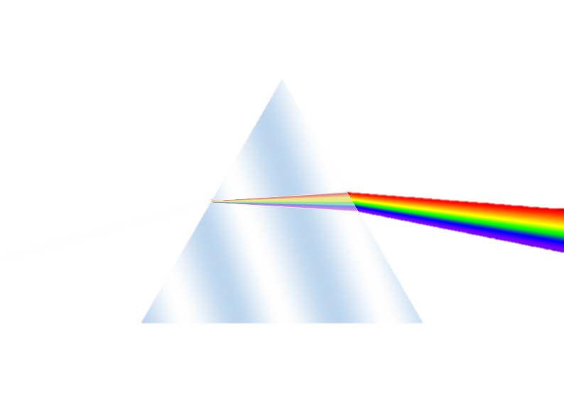
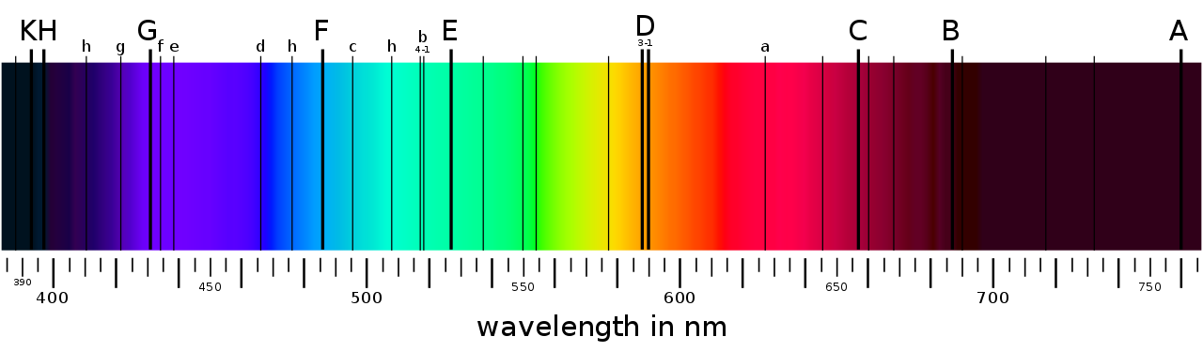
Backstory
Spectroscopy:
Joseph von Fraunhofer, 1814, Sunlight:

Slide 6

Backstory
Spectroscopy:
Johann Balmer, 1885, Emission of Hydrogen:
12/16
21/25
32/36
5/9
1.9
2.6
2.9
3.42
3.05 eV

Slide 7
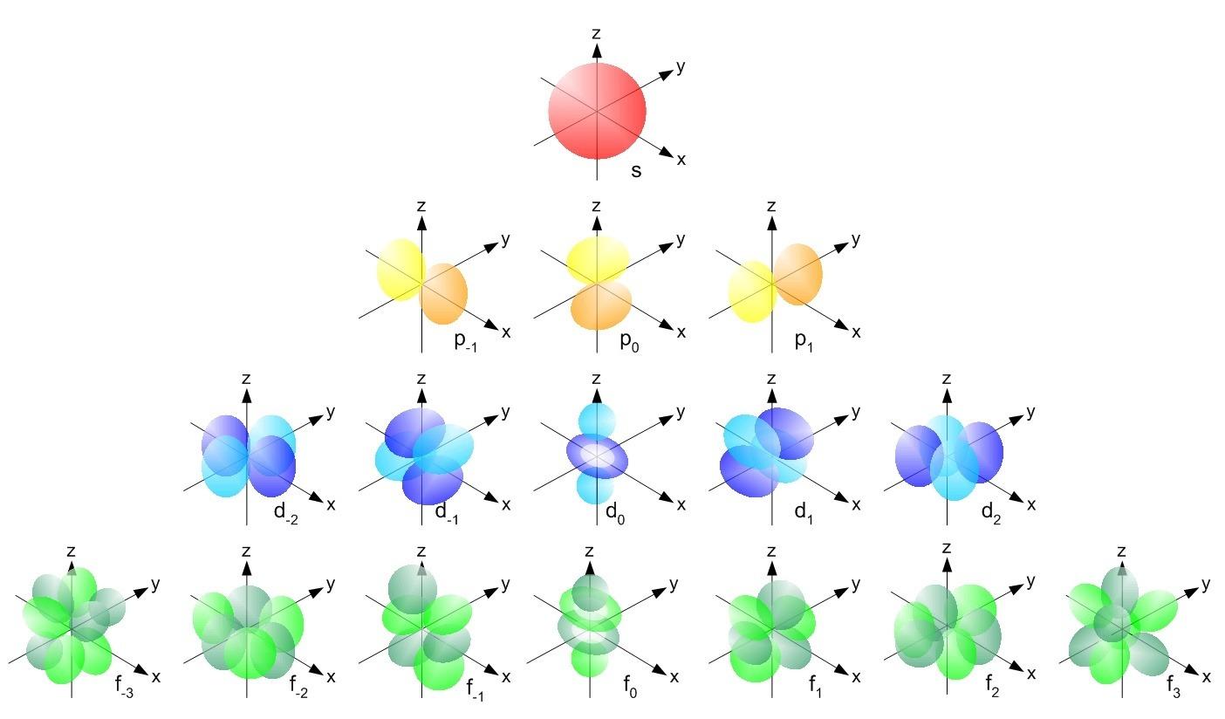
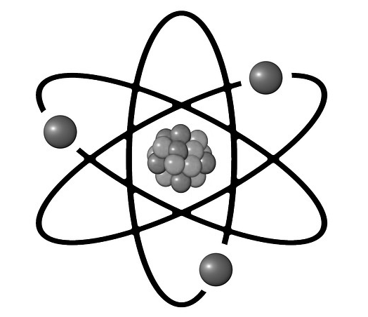
Backstory
The Atom

Slide 8
Motivation: Atomic, Molecular, & Optical Physics
AMO Physics: Repeatability, Precision.
Indistinguishability
Symmetry, enabling optical
AMO Physics: Trade low Entropy for…
Long Range Interactions
New Quantum Phases
Decoupled Transitions
Relevance to Chemistry,
pumping, cooling.
Astrophysics, Biology.
Image credit: Paul Kent, National Center For Computational Sciences, Ornl/Jorge Sofo, Penn State University/Science Photo Library

Slide 9
Motivation
How much Entropy is acceptable…
Techniques
Species
Cryogenic Sources
Stark Deceleration
Most Species
OH, NH₃, CO, SO₂, H₂CO, YbF
Laser cooling
Opto-electric Cooling
YbF, SrF, CaF, YO
CH₃F
Atomic Cooling and Photo-Association
KRb, NaK
RbCs, LiRb, etc
Temperature
Temperature
Density
Density

Slide 10
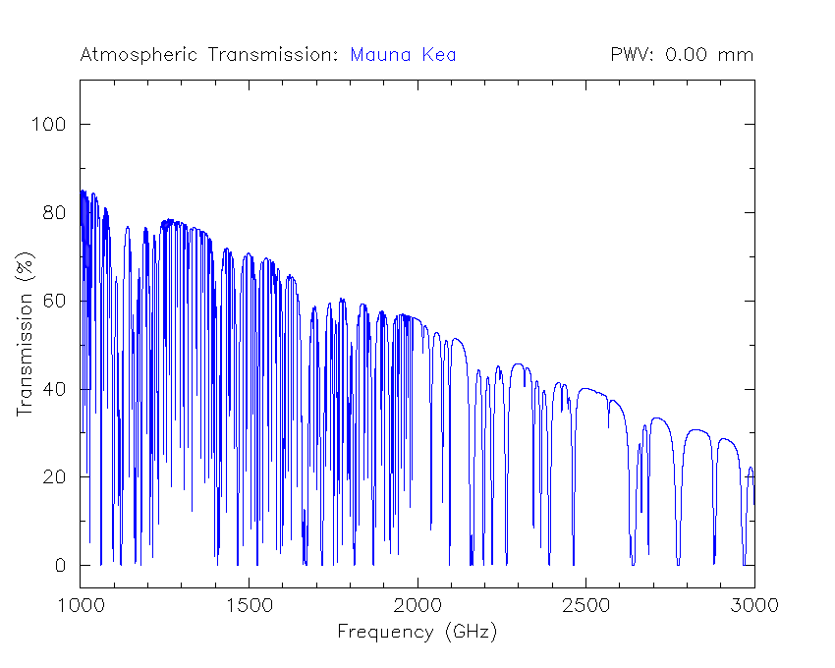
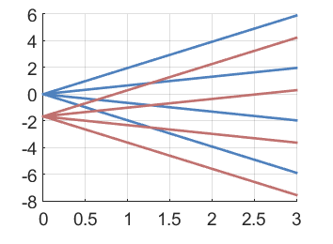
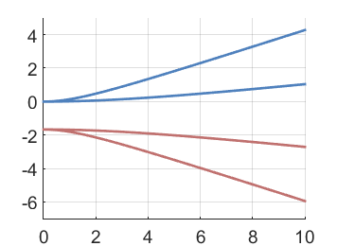
Motivation: Hydroxyl Radicals OH•
Starts with Spectroscopy:
980 THz Electronic
112 THz Vibration
567 GHz Rotation
Hund’s Case (a), X²Π_{3/2}
S
H
Transmission
L
Σ
O
Λ
Ω
Wavelength
Zeeman Effect
Stark Effect
3/2
3/2
1/2
f
1/2
Energy (GHz)
m_{J}
|m_{J}|
Energy (GHz)
-1/2
e
-1/2
-3/2
-3/2
Magnetic Field (kG)
Electric Field (kV/cm)

Slide 11
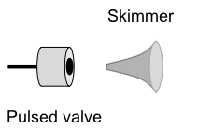
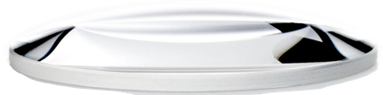
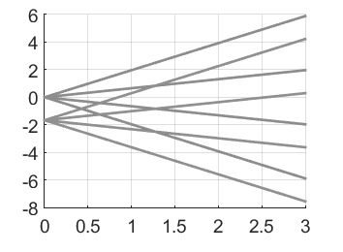
Experimental Apparatus
.…
(333)
LIF Detection
Microwave Coupling
1. 7 GHz – 2.7 MHz/kG
m_{J}
313nm (73%)
3/2
282nm
1/2
Energy (GHz)
-1/2
Bochinski et al, PRL 91, 243001, (2003)
Hudson et al, PRL 98, 253002, (2007)
Sawyer et al, PRL 101, 203203 (2008)
Stuhl et al, PRA 85, 033427 (2012)
-3/2
Magnetic Field (kG)
Notes:
After loading into trap for 10ms We have a well thermalized 45mK sample which can be fit by Boltzmann distribution

Slide 12
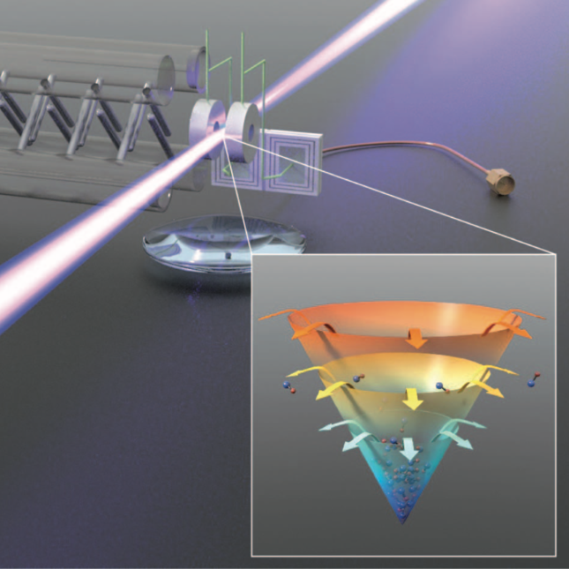
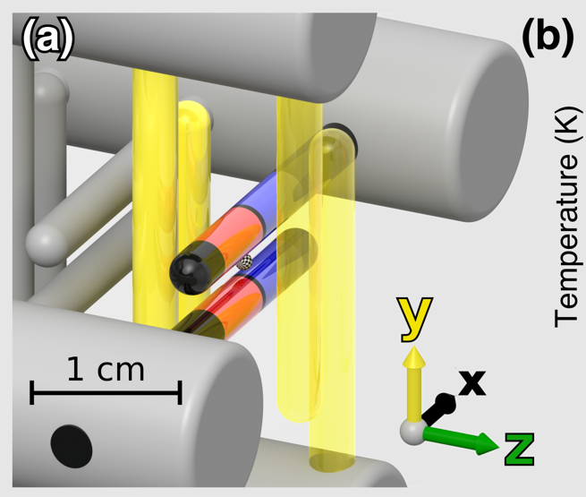
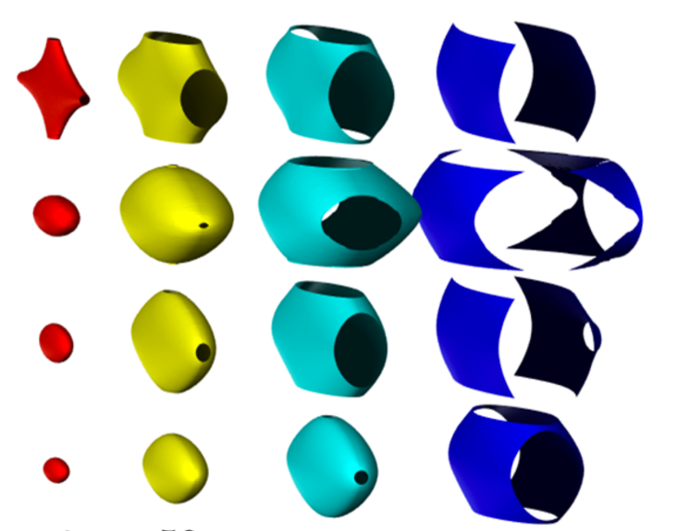
How to Push the Limits
Evaporative Cooling
Solving Spin-Flip Losses
New Deceleration Strategy

Slide 13
Evaporative Cooling
Shortcut to low entropy:
Techniques
Species
Cryogenic Sources
Stark Deceleration
Most Species
OH, NH₃, CO, SO₂, H₂CO, YbF
Laser cooling
Opto-electric Cooling
YbF, SrF, CaF, YO
CH₃F
Evaporative Cooling
Atomic Cooling and Photo-Association
KRb, NaK
RbCs, LiRb, etc
Temperature
Temperature
Density
Density

Slide 14
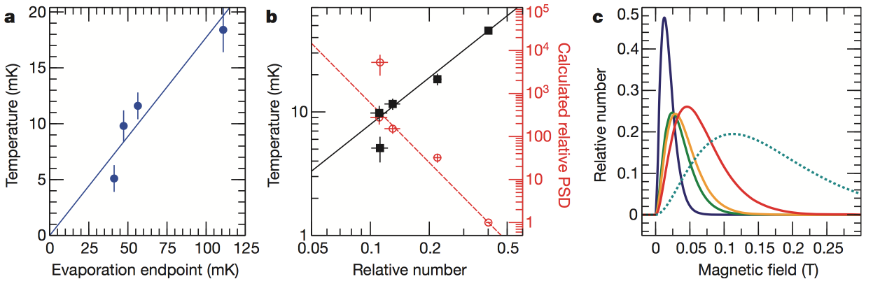
Evaporative Cooling
First Demonstrated in our experiment!
Next: Going even colder.
Stuhl et al, Nature 492, 7429 (2012)

Slide 15
Evaporative Cooling
The scheme in further detail:
Population should build up in this region
Microwave Coupling
1. 7 GHz – 2.7 MHz/kG
m_{J}
3/2
Laser induced fluorescence on opposite parity state
1/2
Energy (GHz)
Use small E-field to mix states and allow escape
-1/2
-3/2
Ruled out population build-up!
Added a pair of microwave tones
Magnetic Field (kG)
Stuhl et al, Nature 492, 7429 (2012)

Slide 16
Evaporative Cooling
First Demonstrated in our experiment!
First disproval of the first demonstration!
Not completely, see appendix of
Why doesn’t it work? Spin-Flip Losses
Reens et al, PRA 96, 063420 (2017)
Stuhl et al, Nature 492, 7429 (2012)

Slide 17
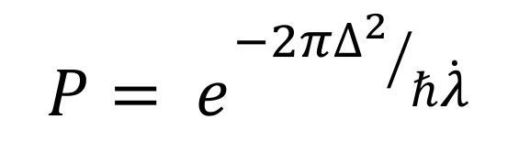
Spin-Flip Losses
Also Majoranna Loss, Landau-Zener Transitions
E
𝛌 𝝙
H = ( )
2𝝙
𝝙 -𝛌
$$P= e^{{−2π∆^{2}}/{ℏ\dot{λ}}}$$
𝛌

Slide 18
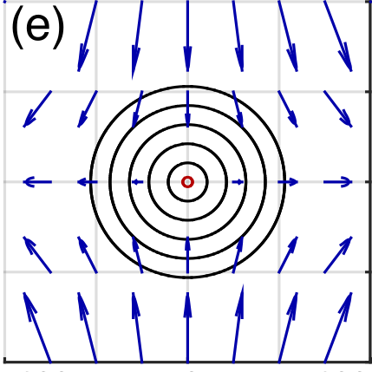
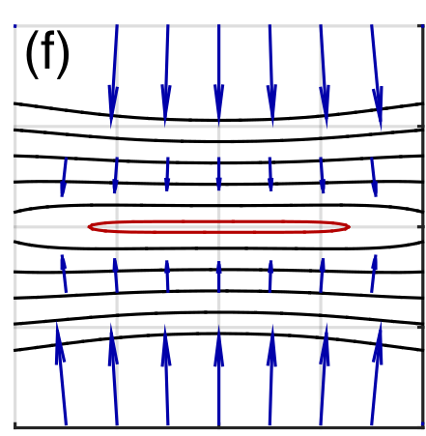
Solving Spin-Flip Losses
Zoom:
No Electric Field
E = 150 V/cm
100
50
0
-50
-100
100
50
0
-50
-100
Weak Axis (𝜇m)
Weak Axis (𝜇m)
-50 -25 0 25 50
Strong Axis (𝜇m)
-50 -25 0 25 50
Strong Axis (𝜇m)
Reens et al, PRA 96, 063420 (2017)

Slide 19
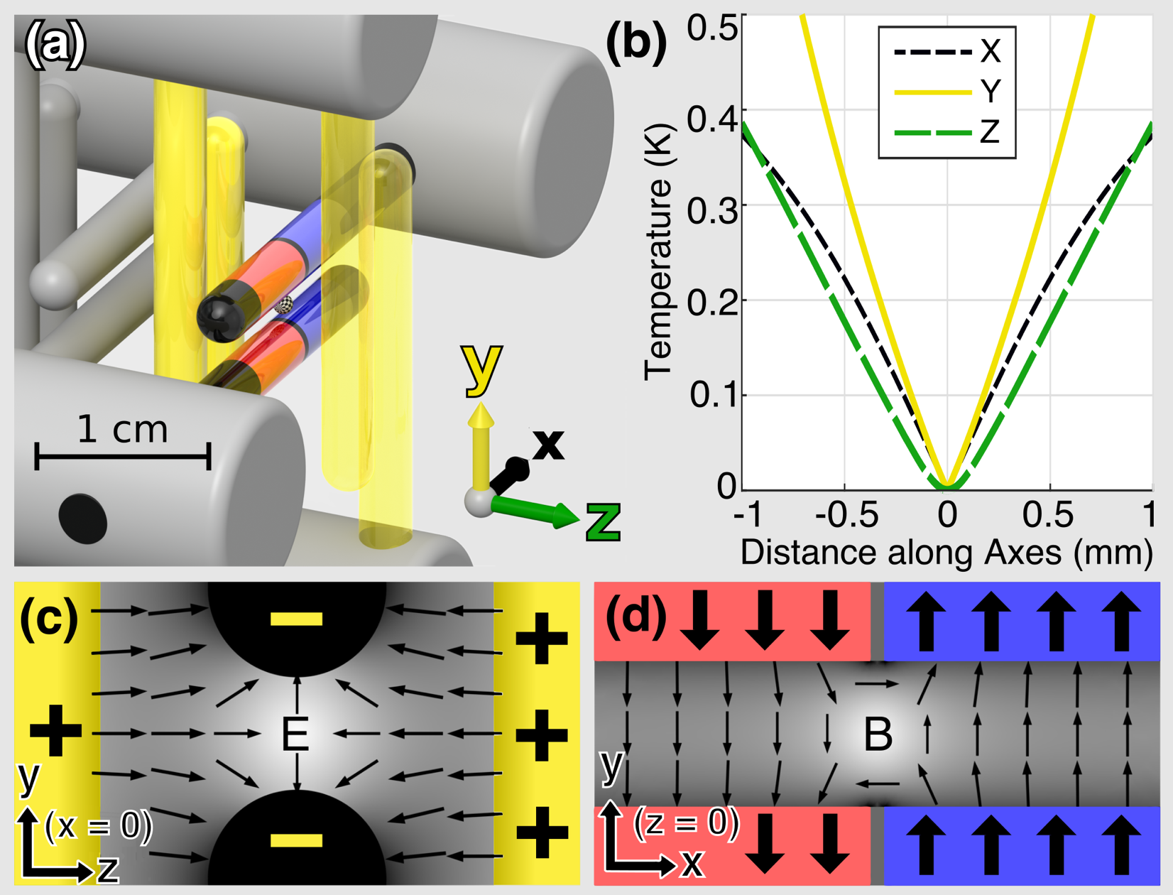
Solving Spin-Flip Losses
Reens et al, PRA 96, 063420 (2017)

Slide 20
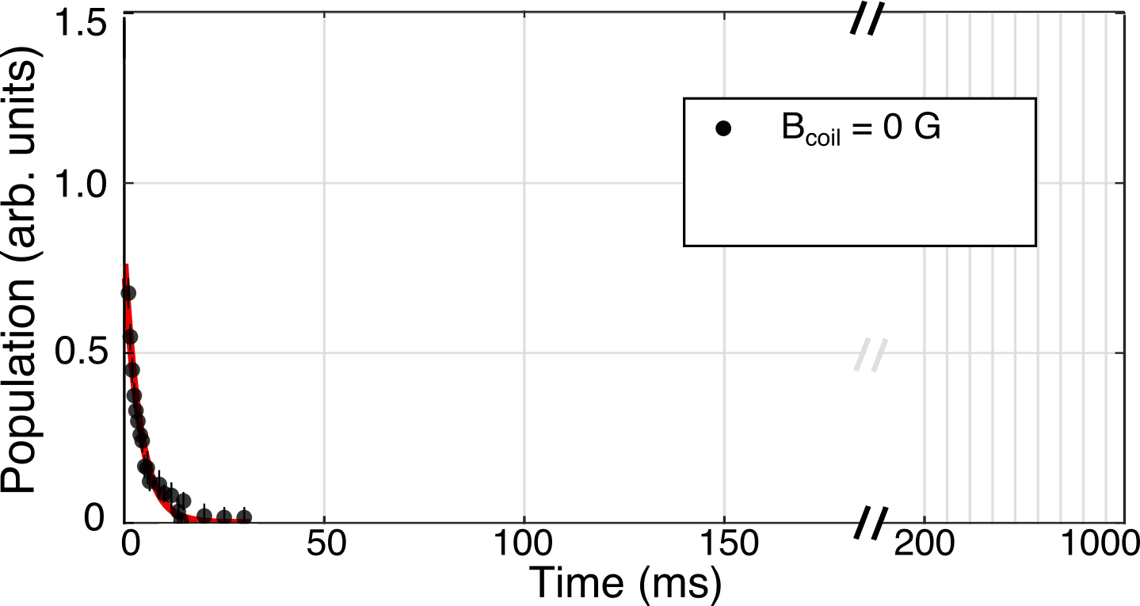
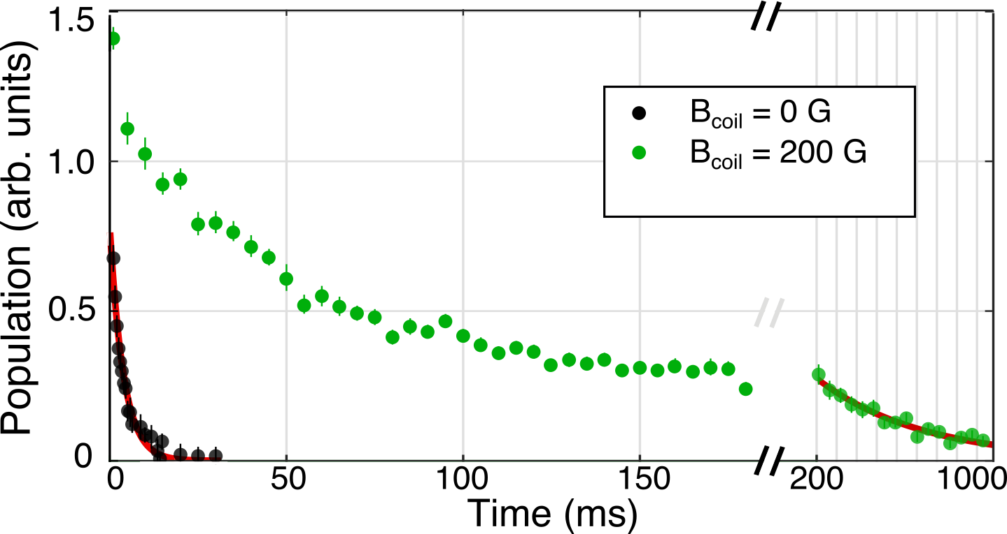
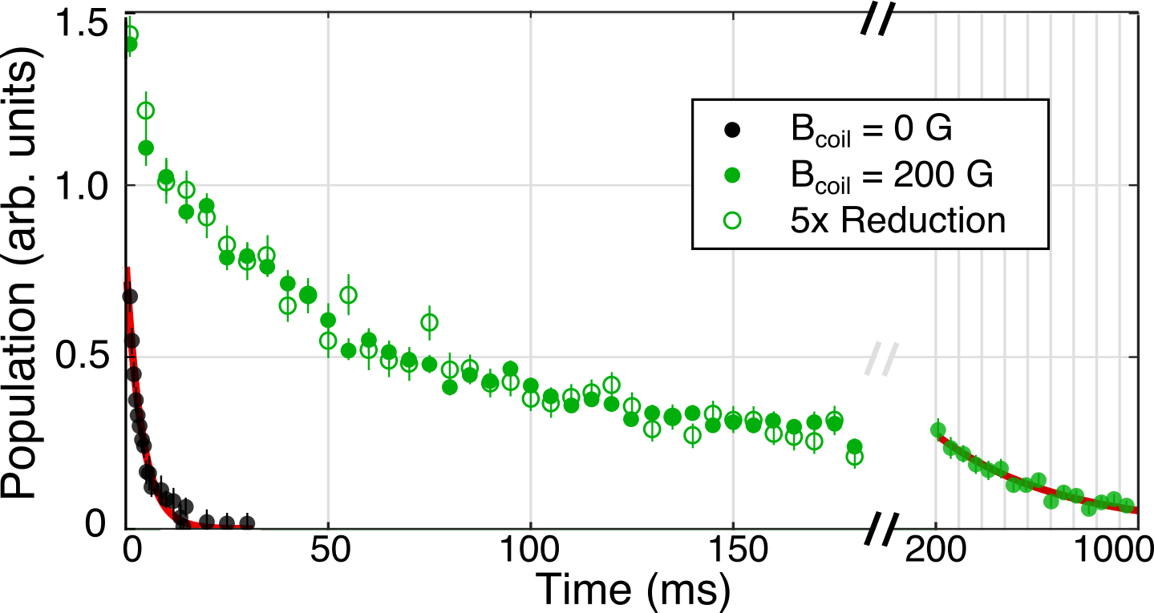
Solving Spin-Flip Losses
Trap allows loss to be removed with bias field:
Pure 2-body Fit
Fits: 200 s⁻¹, 2 s⁻¹
Reens et al, PRA 96, 063420 (2017)

Slide 21
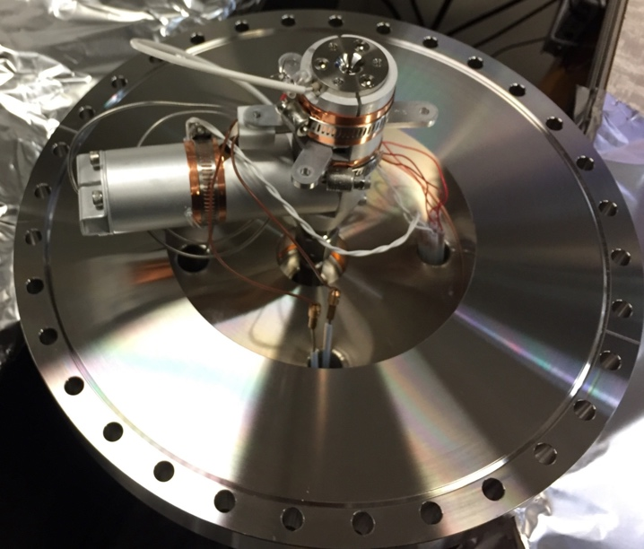
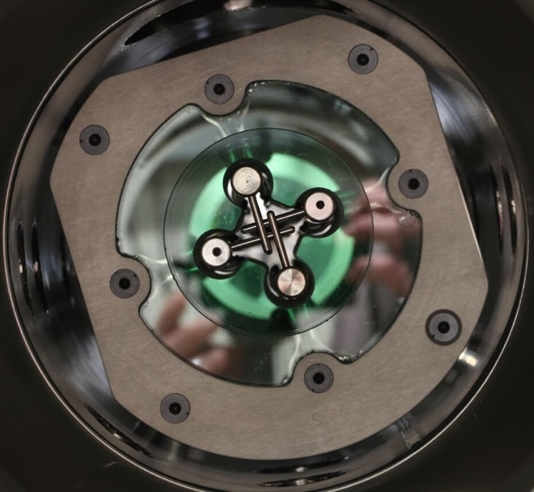
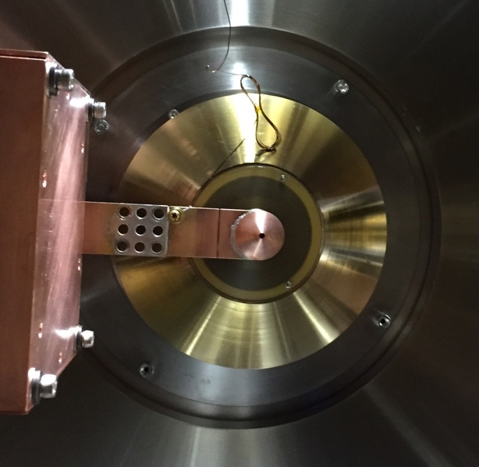
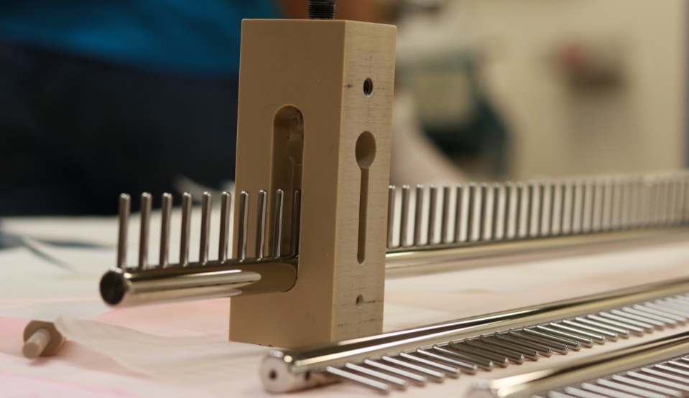
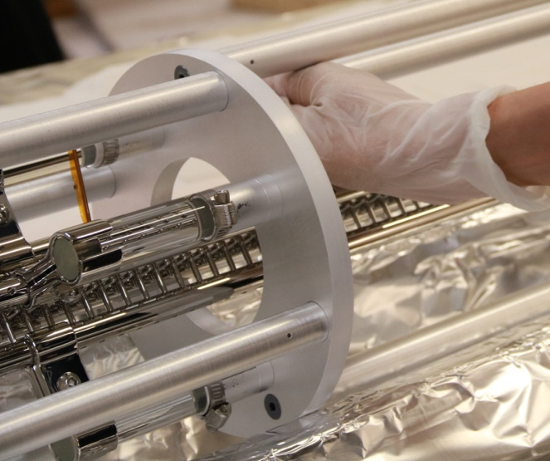
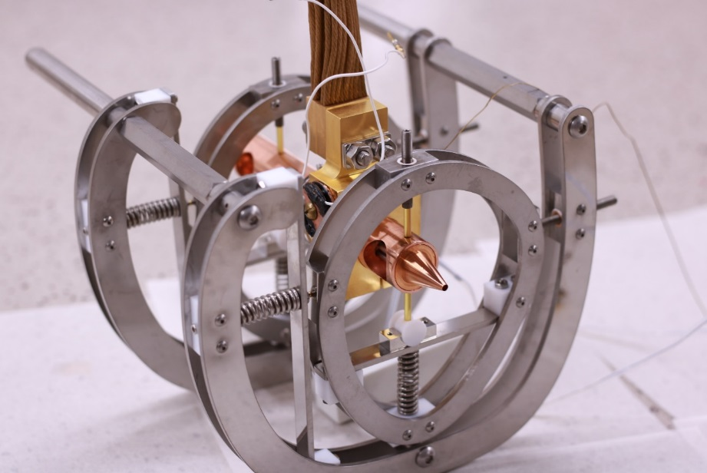
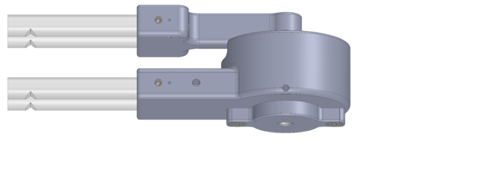
Solving Spin-Flip Losses
Trap allows loss to be removed with bias field
But collisions ruled out by density reduction sieve
Next, push density limit with full rebuild:
New High Pressure Pulsed Valve
Lighter carrier gas; longer decelerator
Cryogenic Skimmer
Cryogenic Hexapole
Cryogenic Trap
And Serendipitously…
New Deceleration Strategy
Wu, Reens, et al, PCCP 20, 11615 (2018)

Slide 22
New Deceleration Strategy
Standard Strategy:
S = 1
.…
(333)
Reens, Wu et al, in preparation

Slide 23
New Deceleration Strategy

Slide 24
New Deceleration Strategy
Standard Strategy:
S = 1
New Strategy:
“SF” Strong Focusing
.…
(333)
.…
(333)
Reens, Wu et al, in preparation

Slide 25
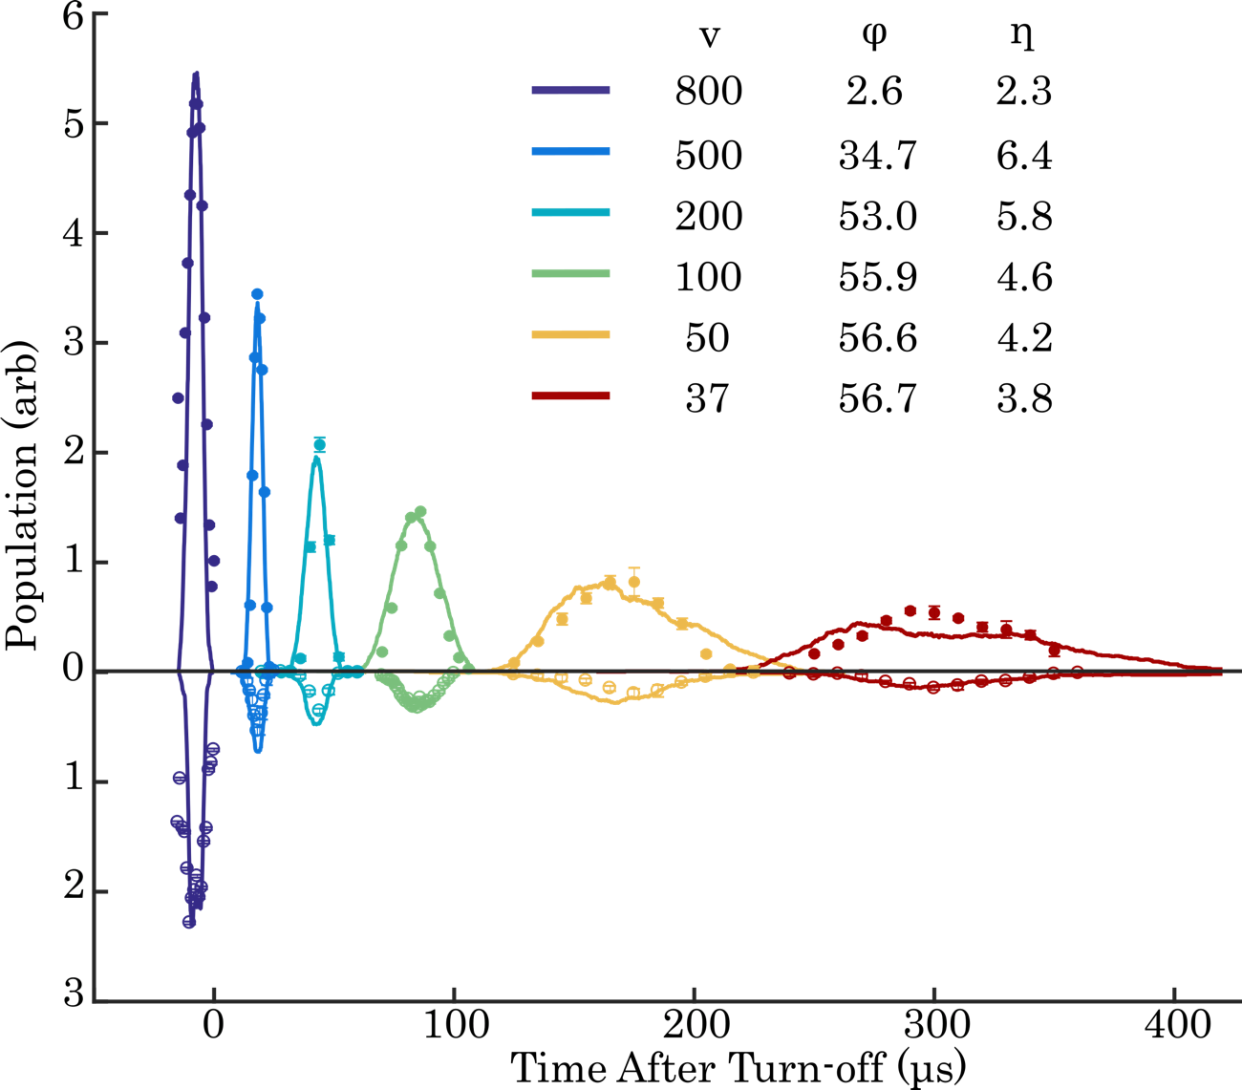
New Deceleration Strategy
Final Speed
Observed Improvement
F Results:
Population (arb)
Detection Time (μs)
Reens, Wu et al, in preparation

Slide 26
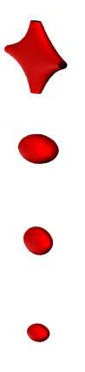
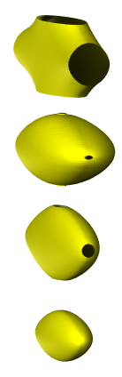
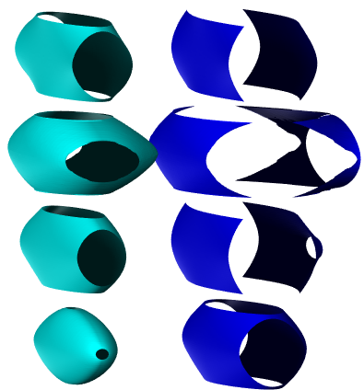
New Deceleration Strategy
Can think about traveling potential wells:
Standard:
y
10
50
100
200
S = 3:
mK
x
z
y
10
50
100
200
F:
mK
x
z
y
10
50
100
200
SF:
mK
x
z
y
10
50
100
200
mK
x
z
Reens, Wu et al, in preparation
Reens et al, in preparation

Slide 27
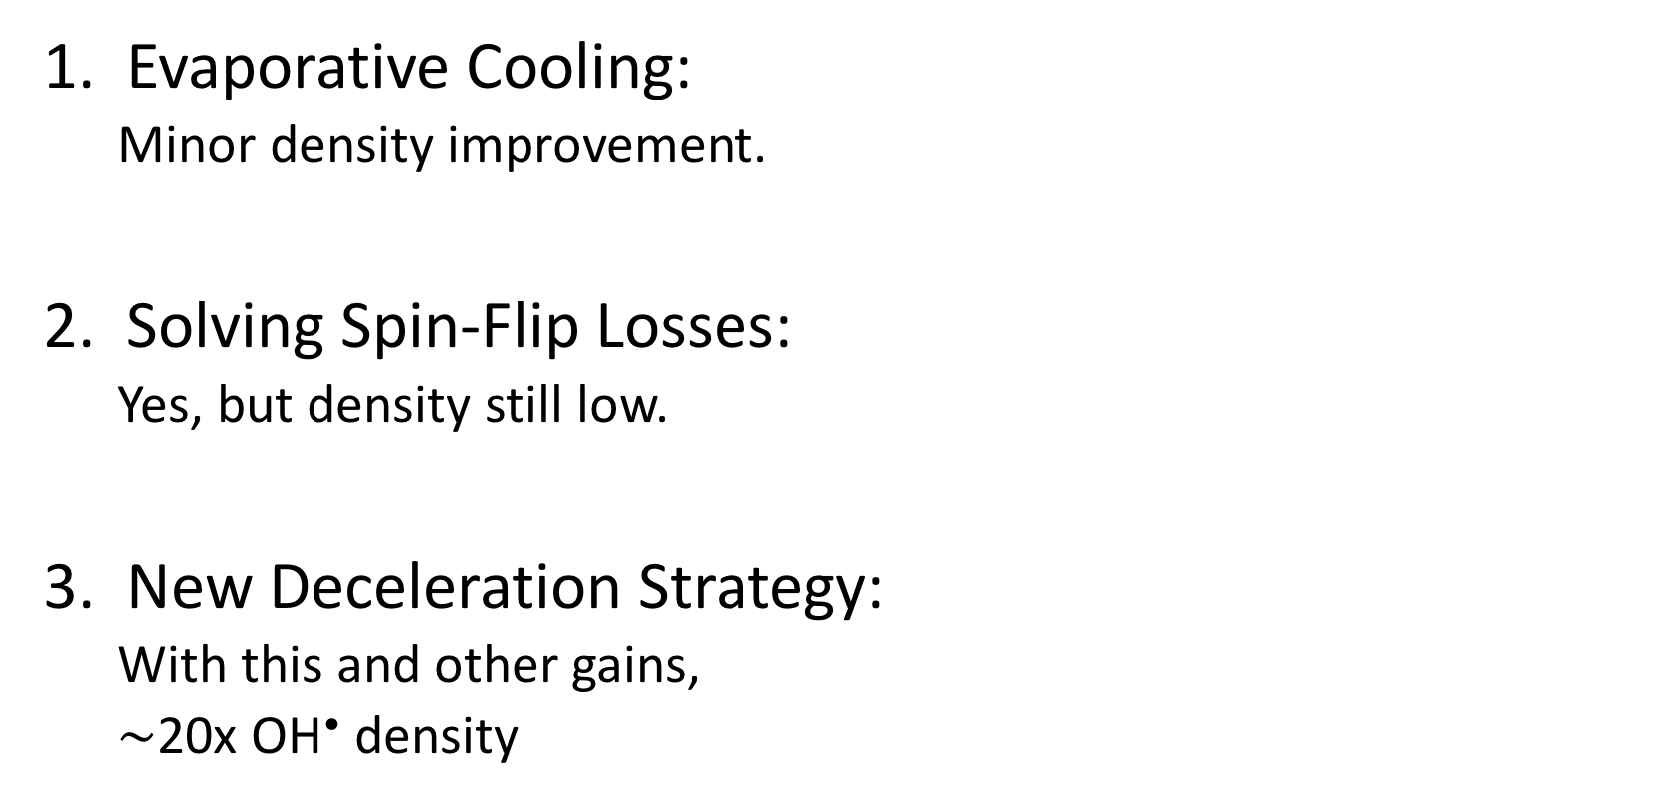
Pushing the Limits
Evaporative Cooling:
Minor density improvement.
Solving Spin-Flip Losses:
Yes, but density still low.
New Deceleration Strategy:
With this and other gains,
$∼$20x OH• density

Slide 28
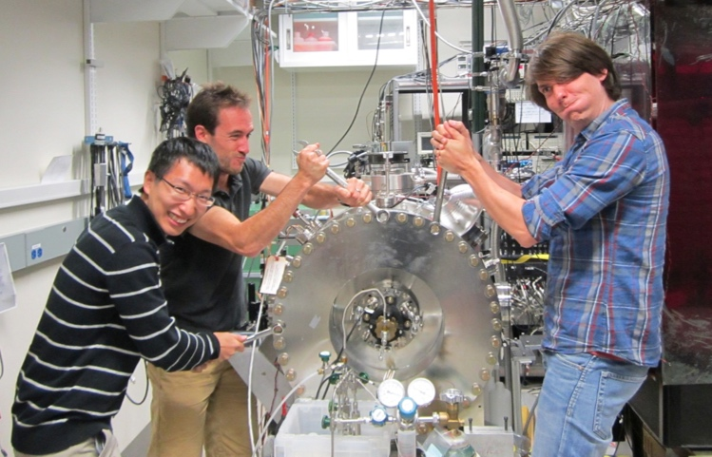
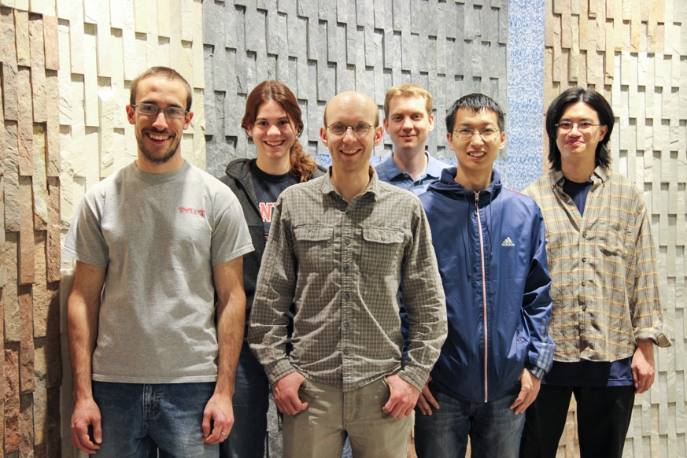
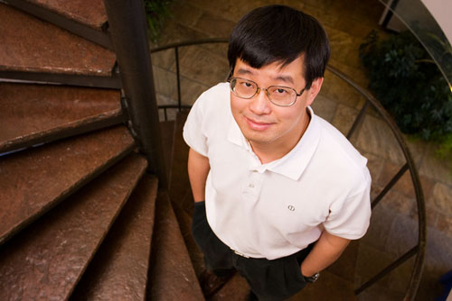






Acknowledgements
Graduate Students:
Ben Stuhl
Hao Wu
Alex Aeppli
Postdocs:
Matt Hummon
Tim Langen
Piotr Wcisło
Undergraduates:
Tong Punsuebsay
Daniela Fontecha
Anna McAuliffe
Family:
Abby
Nathan
Sammy
Jun Ye

Slide 29
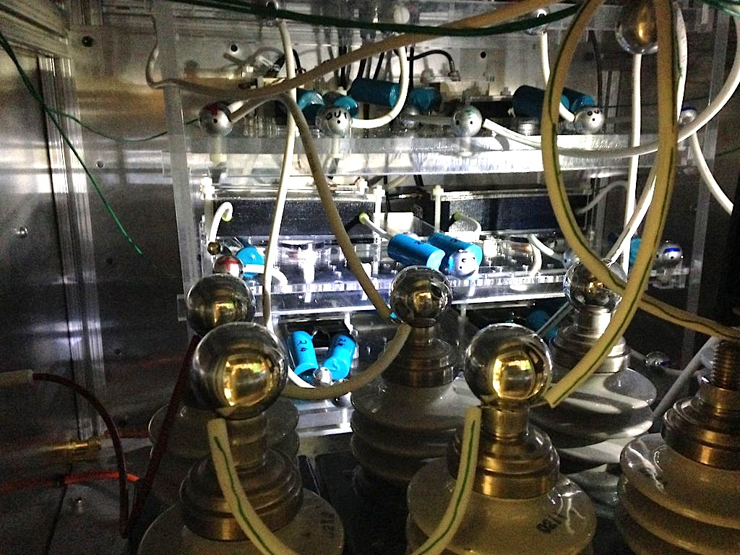

Slide 30
Acknowledgements
Graduate Students:
Ben Stuhl
Hao Wu
Alex Aeppli
Postdocs:
Matt Hummon
Tim Langen
Piotr Wcisło
Undergraduates:
Tong Punsuebsay
Daniela Fontecha
Anna McAuliffe
Family:
Abby
Nathan
Sammy
Jun Ye

Slide 31
Additional Slides

Slide 32
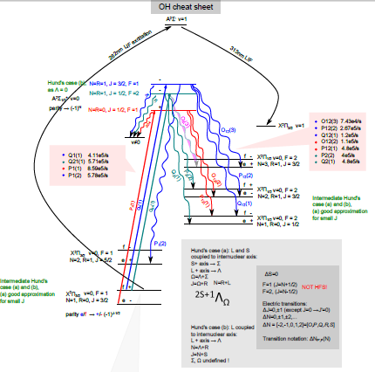
Laser Cooling for OH• ?
30 lasers or so
280-310 nm

Slide 33
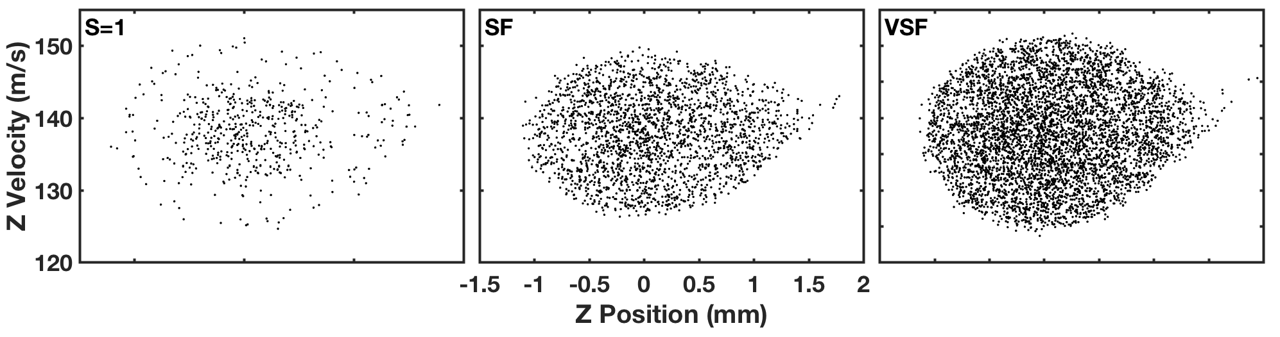
Gains in Density or Number
Both:

Slide 34


Absolute Density Calibration
Compare LIF from OH with Raman scatter from H₂:
Removes errors in collection efficiency calculation.
Suggests n_{OH} $∼$2e5/cm³, free flight, 300 total in trap.
Bischel et al, Applied Optics 25, 1215, 1986

Slide 35
Evaporative Cooling
Density Sieve:

Slide 36



Solving Spin-Flip Losses
E-field necessary for evaporation…
but greatly enhances Spin-Flip Loss: 1s⁻¹ at 50 mK, 100s⁻¹ at 5 mK.
Reens et al, PRA 96, 063420 (2017)
Notes:
2D plot with slices @ different position
Unit
From figure 1 potential energy is highly dependent on B Ebangle EB combined potential
How about OH here we consider top two states upper state 1 lower state 2
Larger area

Slide 37


Evaporative Cooling
Without Buildup, no reasonable fits!
Without Population Buildup:
18 mK
12 mK
10 mK
5 mK
Stuhl et al, Nature 492, 7429 (2012)

Slide 38





Traveling Potential Wells
Standard
S=3
F
SF*
VSF*
TW
Standard
S=3
F
SF*
VSF*
Standard
S=3
F
SF*
Standard
S=3
F
Standard
S=3
Standard
Earlier Trick

